Slide 1
ECE 18-652 Final Project Presentation

Slide 2

Hello!
We are Team A1
Congshan Lv, Guangyu Chen, Jin Gu, Jiyu Shi, Pan Li

Slide 3
Overview
Software Architecture
Features of Our App
How to Test
Practices and Quality attributes
Lessons learned

Slide 4
Software Architecture
1

Slide 5
Technology Selection
HTML, CSS, JavaScript | Basic web building blocks
Bootstrap | Mobile compatibility
Express.JS | Server framework
Node.JS | Runtime environment
SQLite3 | Database

Slide 6
Technology Selection
Github | Version control and issue tracking
Trello | Project and backlog management
CircleCI | Continuous integration

Slide 7
Technology Selection
Selemium IDE | UI, system and acceptance testing
Excel | Documenting for application’s RESTful API
StarUml | Diagram editing, creating UML artifacts
Webstorm | Integrated Development Environment
Istanbul | CodeCoverage
Mocha & Grunt | Used for unit test

Slide 8
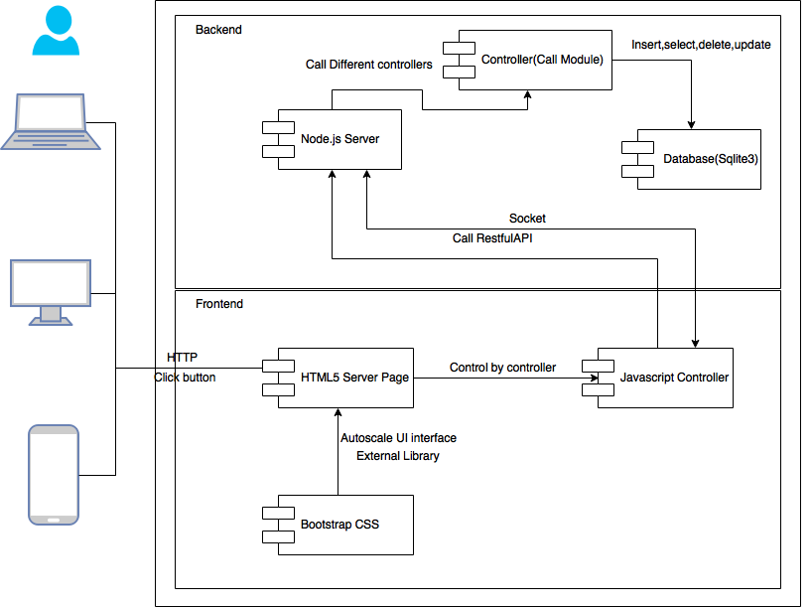

Slide 9
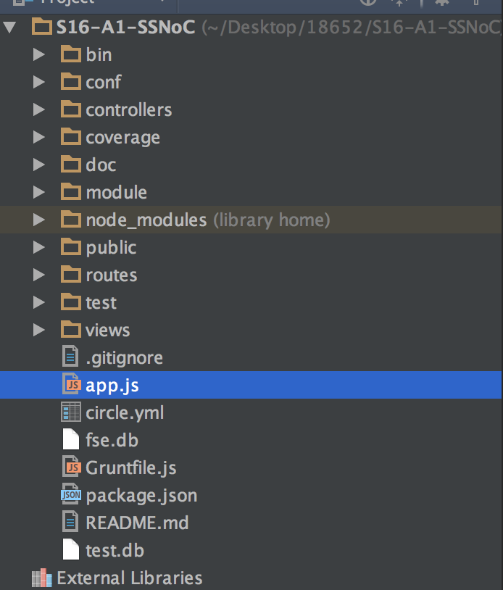
Code Architecture

Slide 10
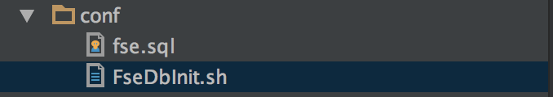
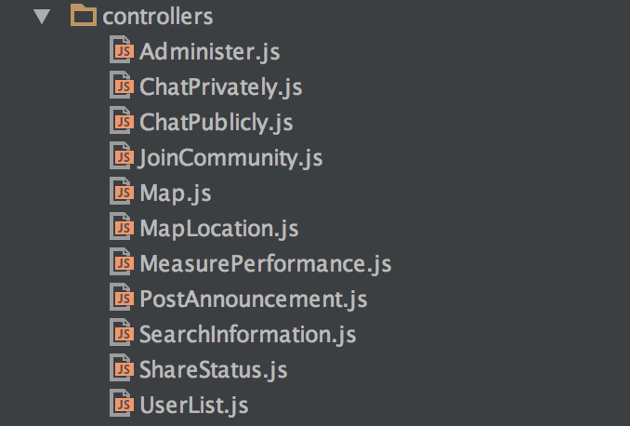
Code Architecture

Slide 11
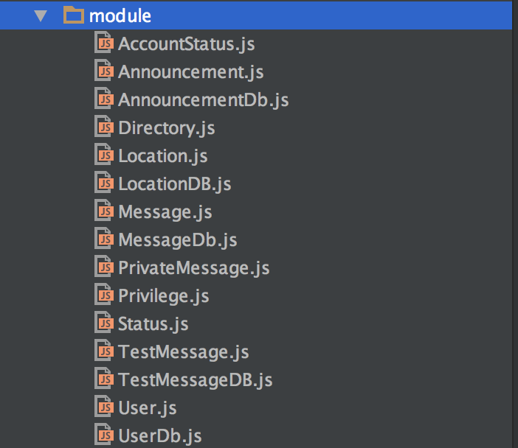
Code Architecture

Slide 12
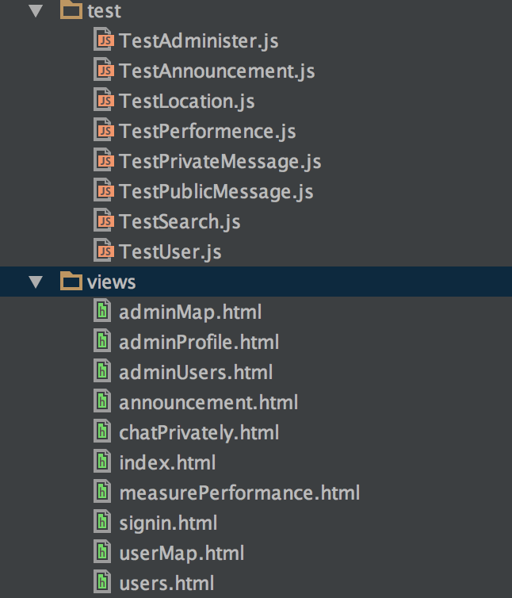
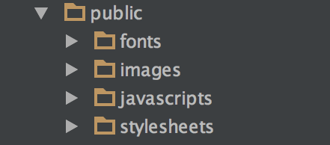
Code Architecture

Slide 13
Code Architecture

Slide 14
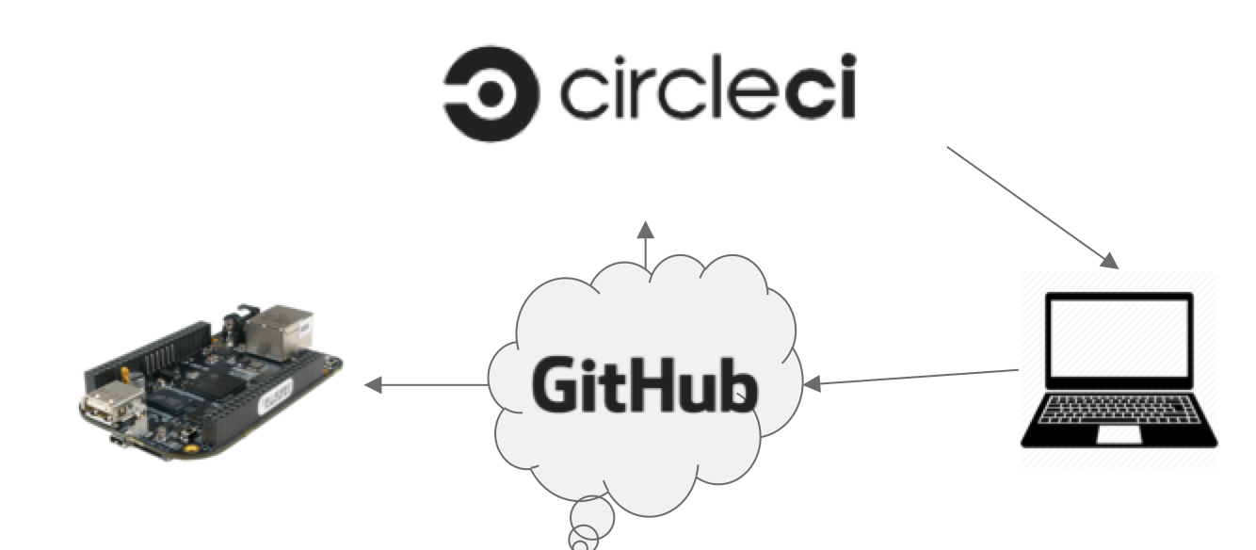
Code Push

Slide 15
Features of Our App
2

Slide 16
What can citizens do?

Slide 17
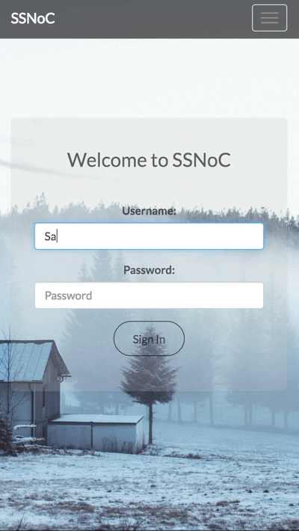
Login
Place your screenshot here
As an existing user, you can login to SSNoC with your username and password.

Slide 18
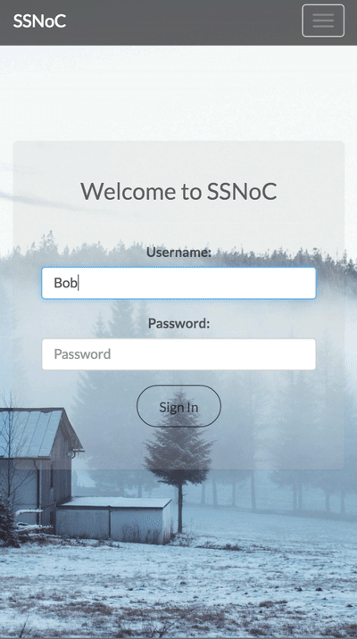
Login as New User
Place your screenshot here
As a new user, you can register and login to SSNoC with your username and password.

Slide 19
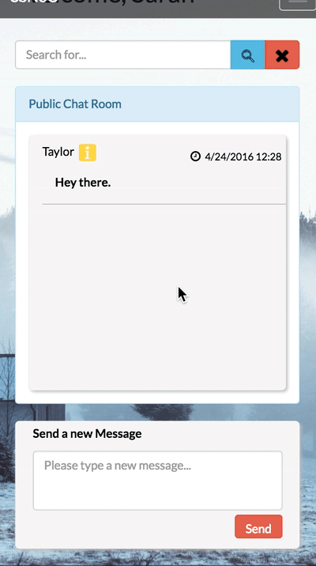
Chat Publicly
Place your screenshot here
Users would enter the public chat room after login, where they would be able to join the public chat.

Slide 20
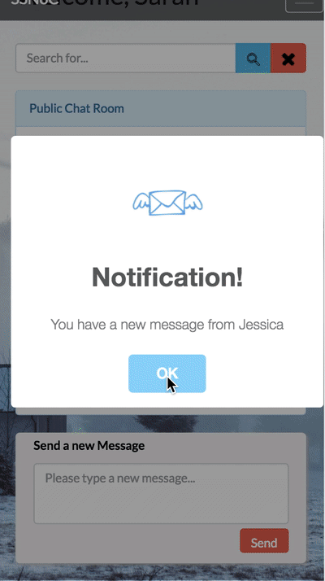
Chat Privately
Place your screenshot here
Users can also have one-on-one conversation with another user.

Slide 21
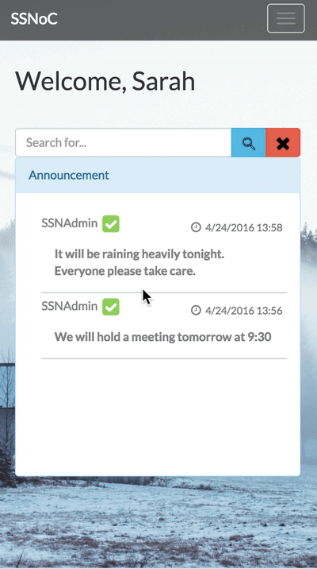
Announcements
Place your screenshot here
Citizens can view/search the announcements posted by the administrator.

Slide 22
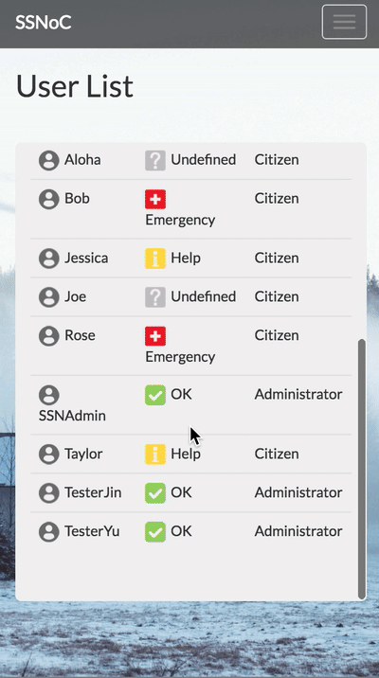
User List
Place your screenshot here
Users can view a list of all users and their status. Users can also search a user by status or username.

Slide 23
What can administrators do?

Slide 24
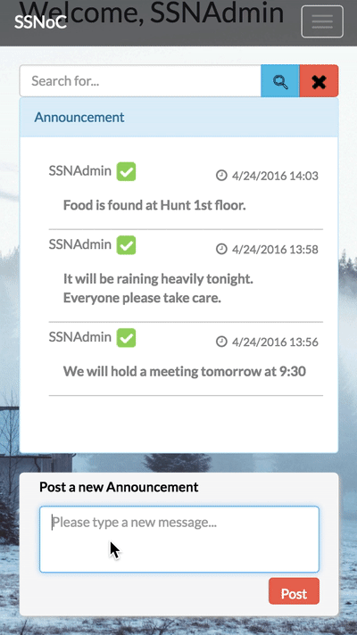
Announcements(admin)
Place your screenshot here
Besides viewing and searching, the administrator also have the privilege to post an announcement.

Slide 25
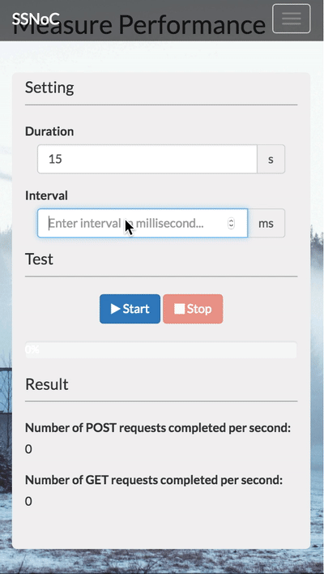
Measure Performance(admin)
Place your screenshot here
Administrators can measure the performance of the system by evaluating the running time of GET/POST requests.

Slide 26
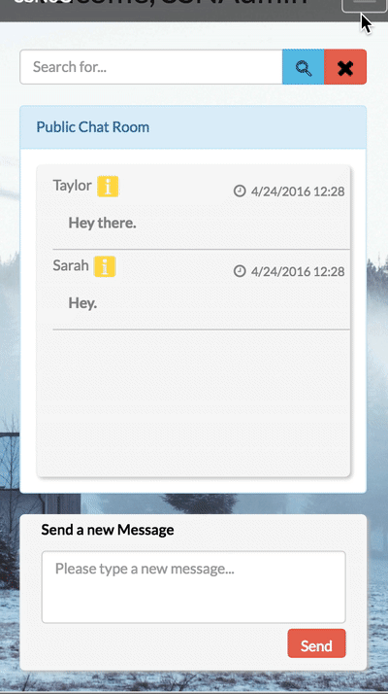
Administer User Profile(admin)
Place your screenshot here
Administrators can modify user profile. The user would be logged out if there is a modification on his profile.

Slide 27
Unique Feature

Slide 28
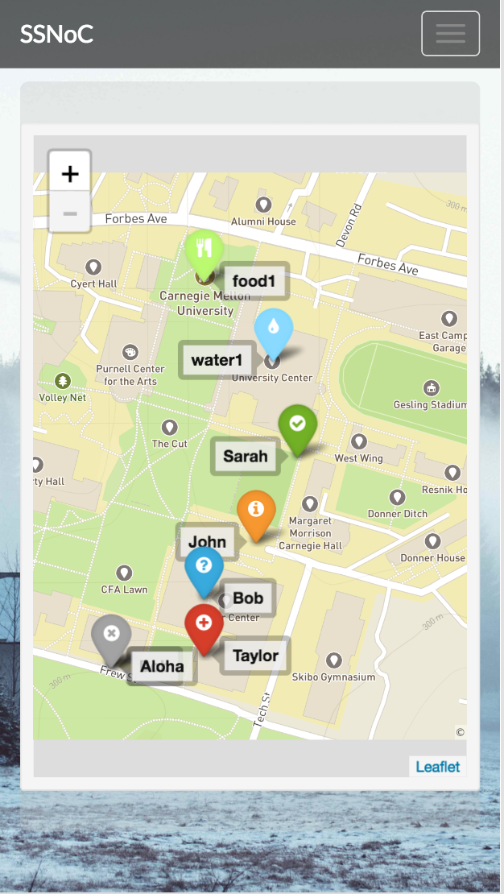




Map(unique feature)
Place your screenshot here
Users can share their locations on the map, and also see where other users are.
OK Emergency
Help Undefined
Offline
?

Slide 29
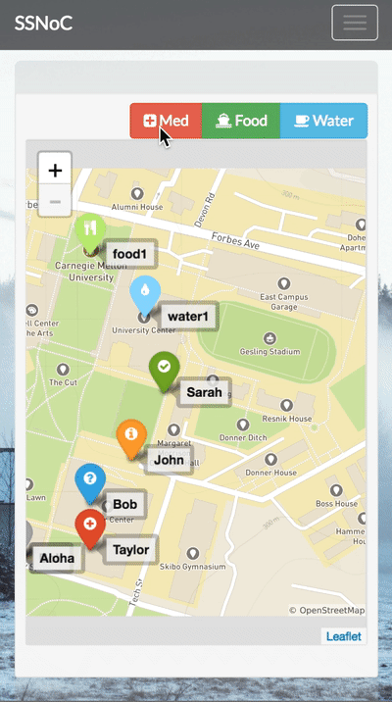
Map(unique feature)
Place your screenshot here
Administrators can mark the map with markers such as food, medicine, and water.

Slide 30
Individual Features

Slide 31
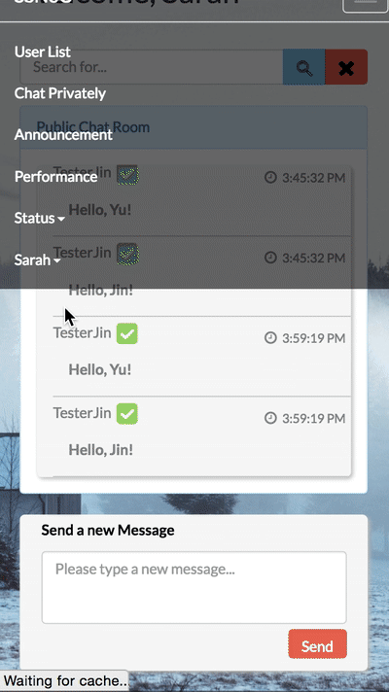
Modify Profile(Jiyu Shi)
Place your screenshot here
Users can modify their own profiles.

Slide 32
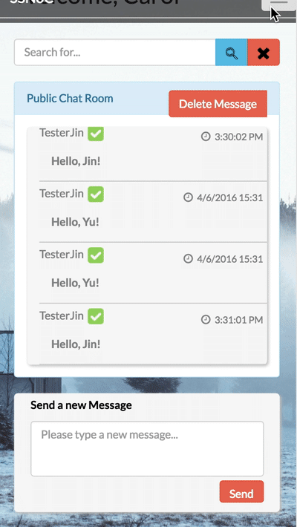
Delete Message(Pan Li)
Place your screenshot here
Users can delete messages in multiple ways: single, multiple, time period.

Slide 33
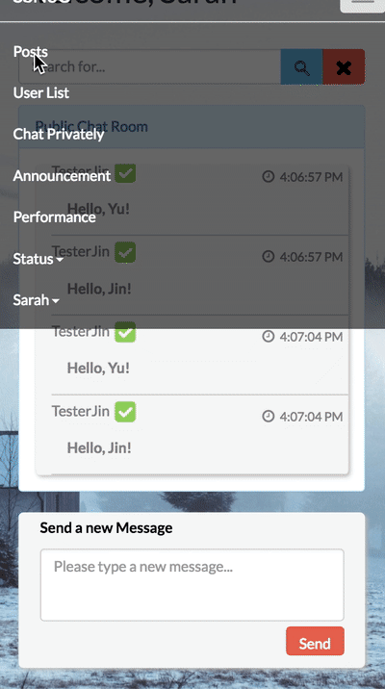
Posts(Congshan Lv)
Place your screenshot here
Users can send posts, and also view posts from other people.

Slide 34
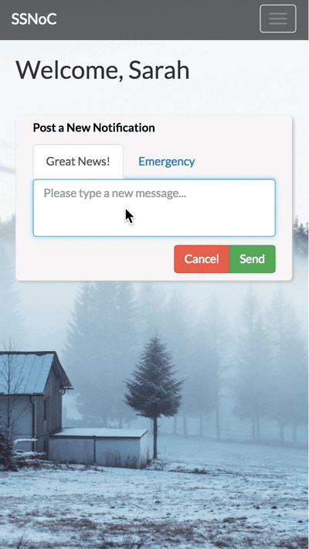
Alerts(Guangyu Chen)
Place your screenshot here
Users can receive alert, in situation of emergency. The sound of the alert is different in different situations.

Slide 35
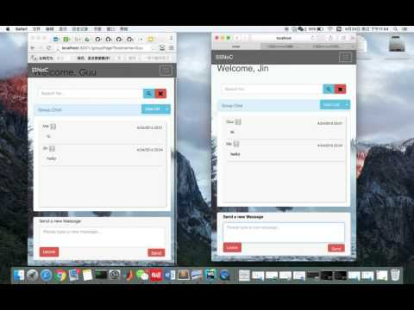
Group Chat(Jin Gu)
Place your screenshot here
Users can invite other people into a chat group, and hold private conversations within the group.

Slide 36
How to Test
3

Slide 37
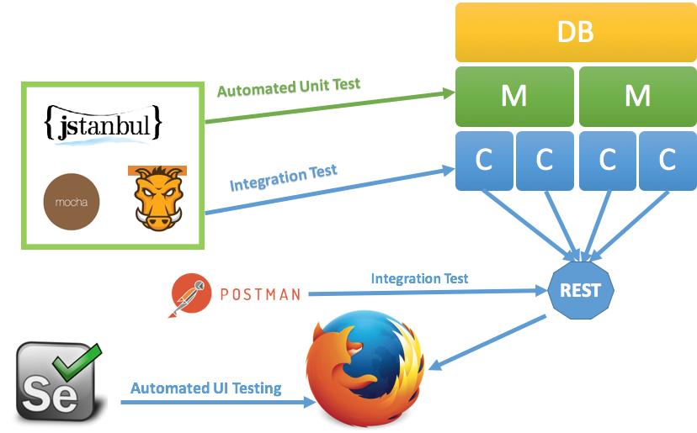
Test Overview

Slide 38
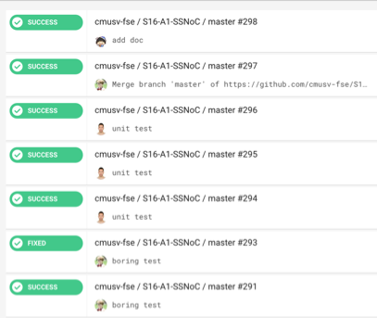
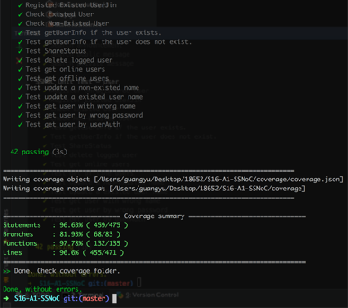
Automated Unit Test

Slide 39
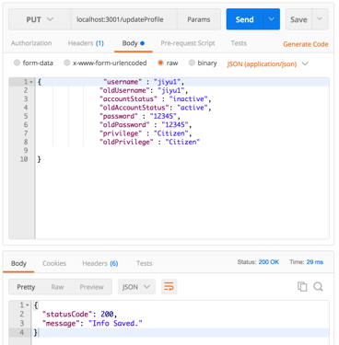
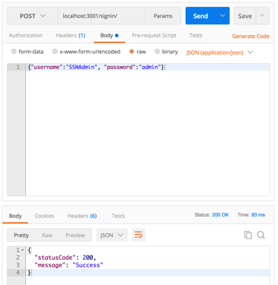
REST Integration Test

Slide 40
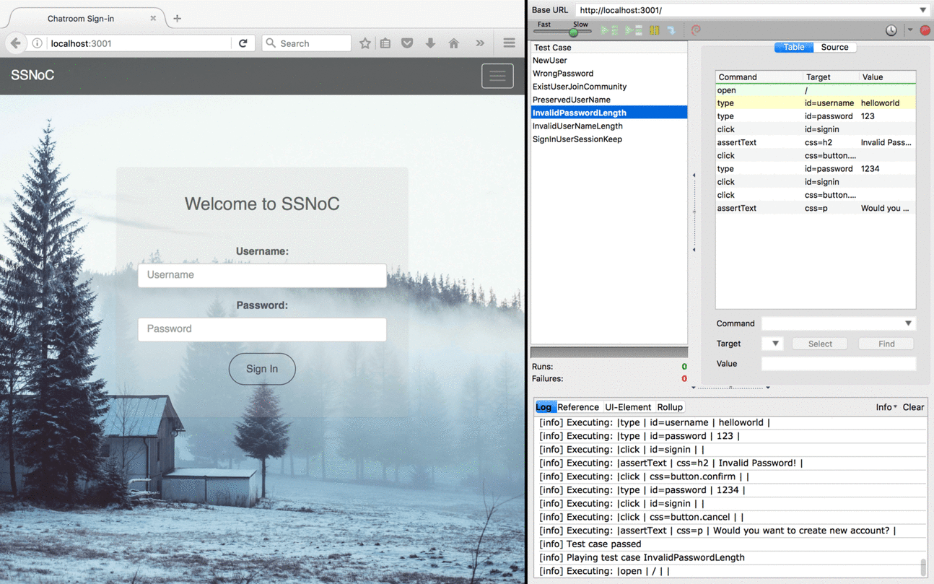
Automated UI Test

Slide 41
Practices and Quality attributes
4

Slide 42
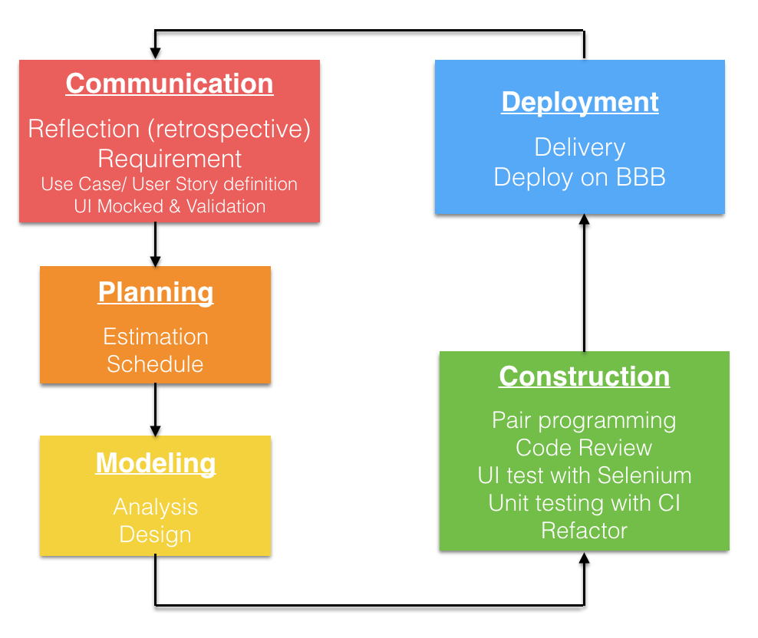
Software Engineering Practices

Slide 43
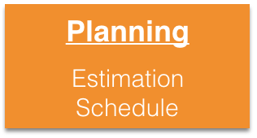
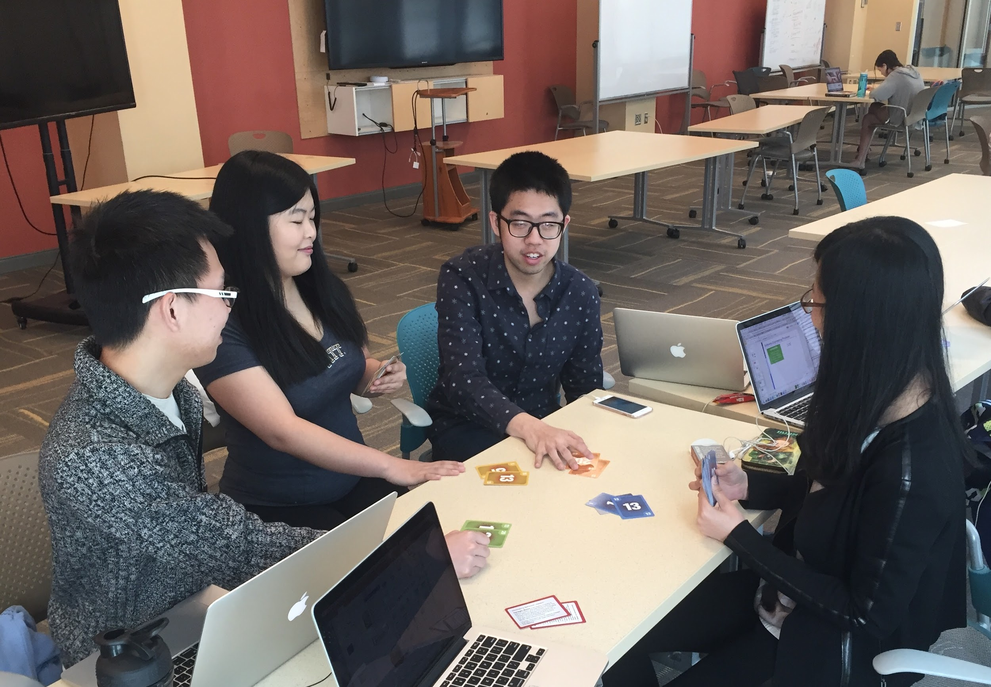
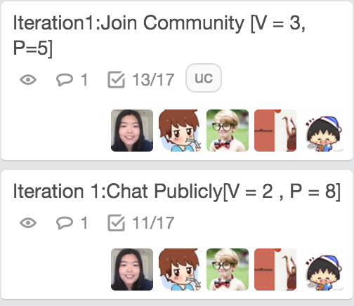
Software Engineering Practices

Slide 44
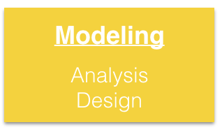
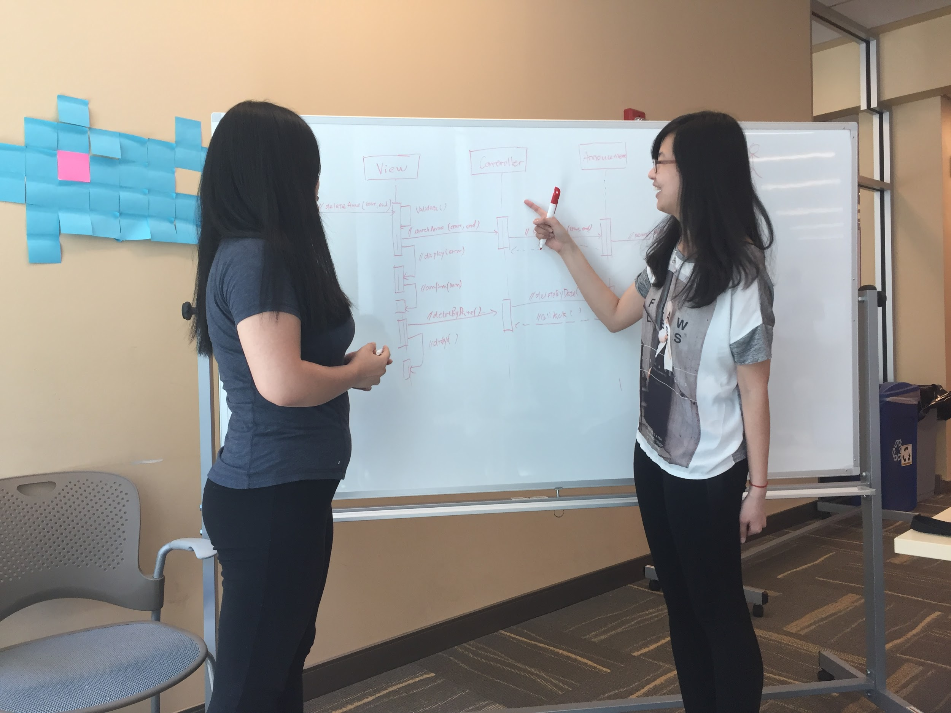
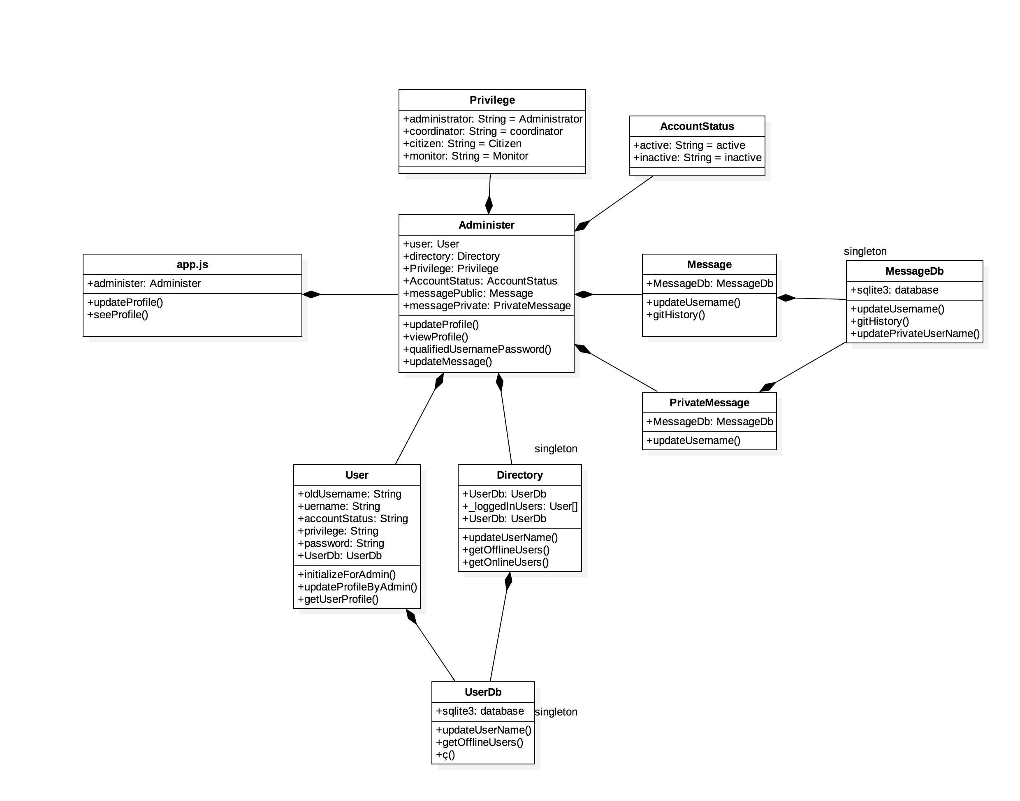
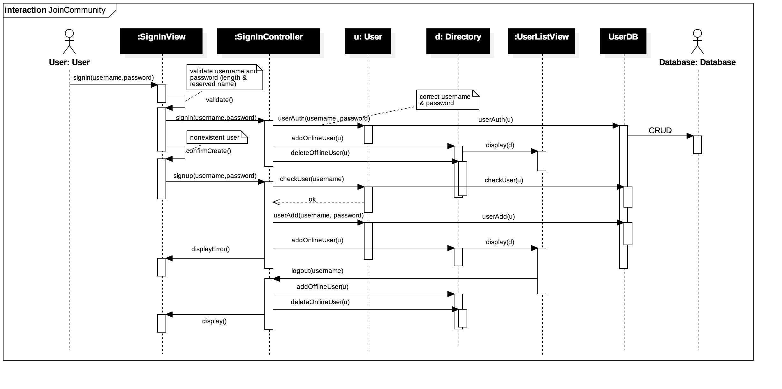
Software Engineering Practices

Slide 45
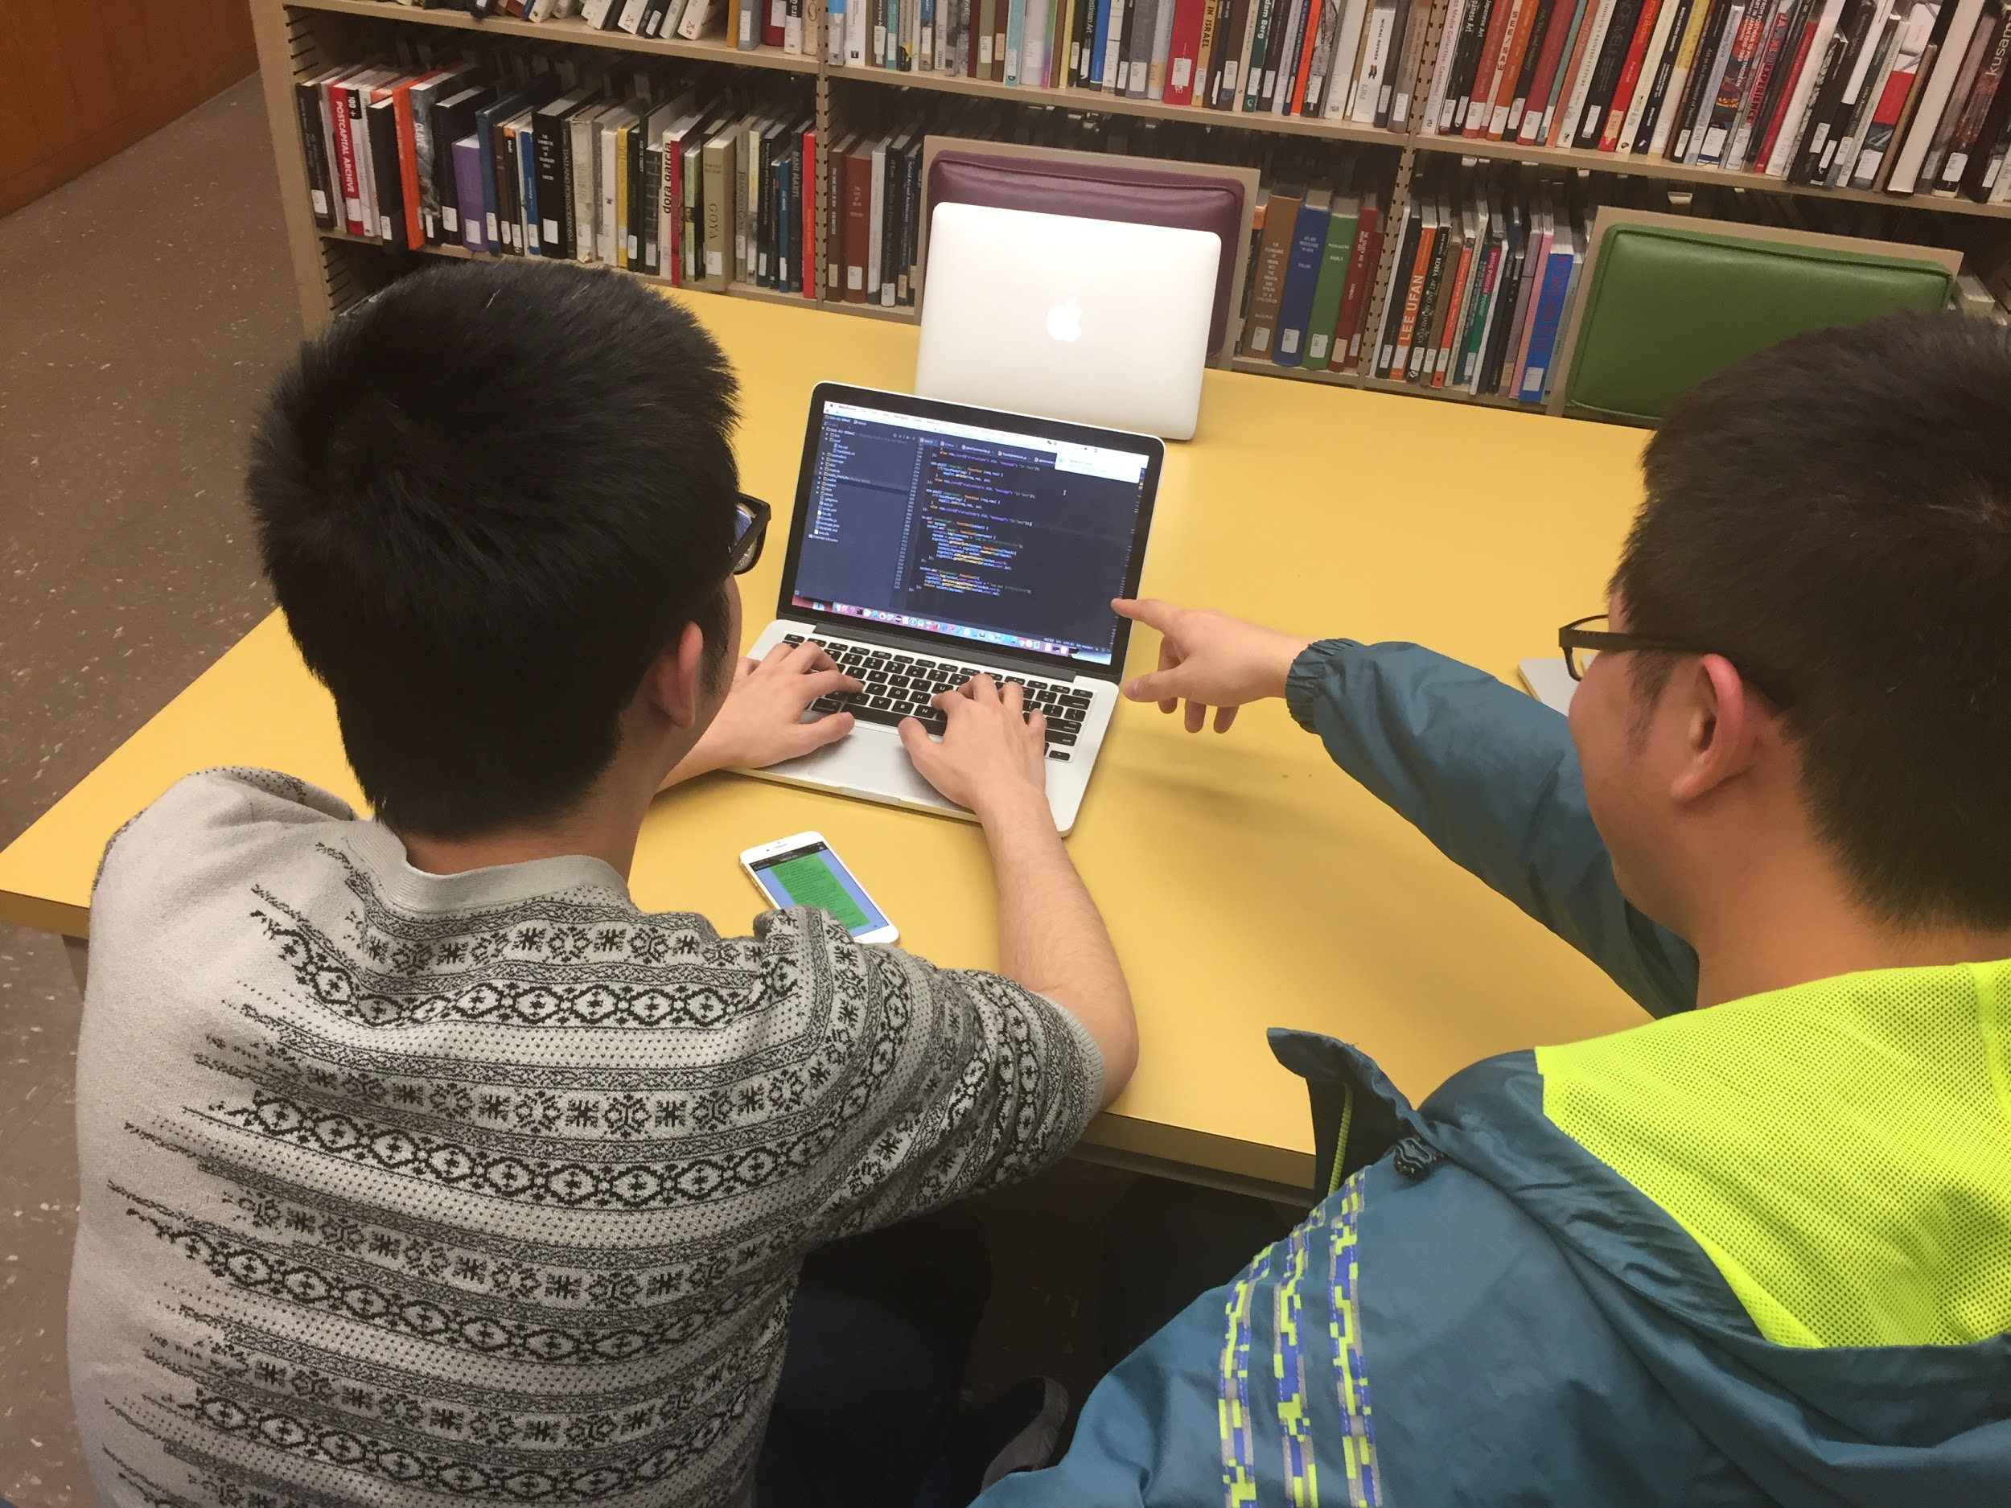
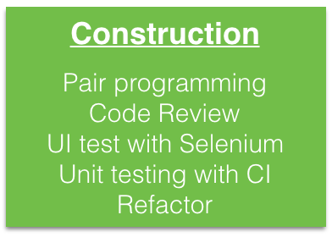
Software Engineering Practices

Slide 46
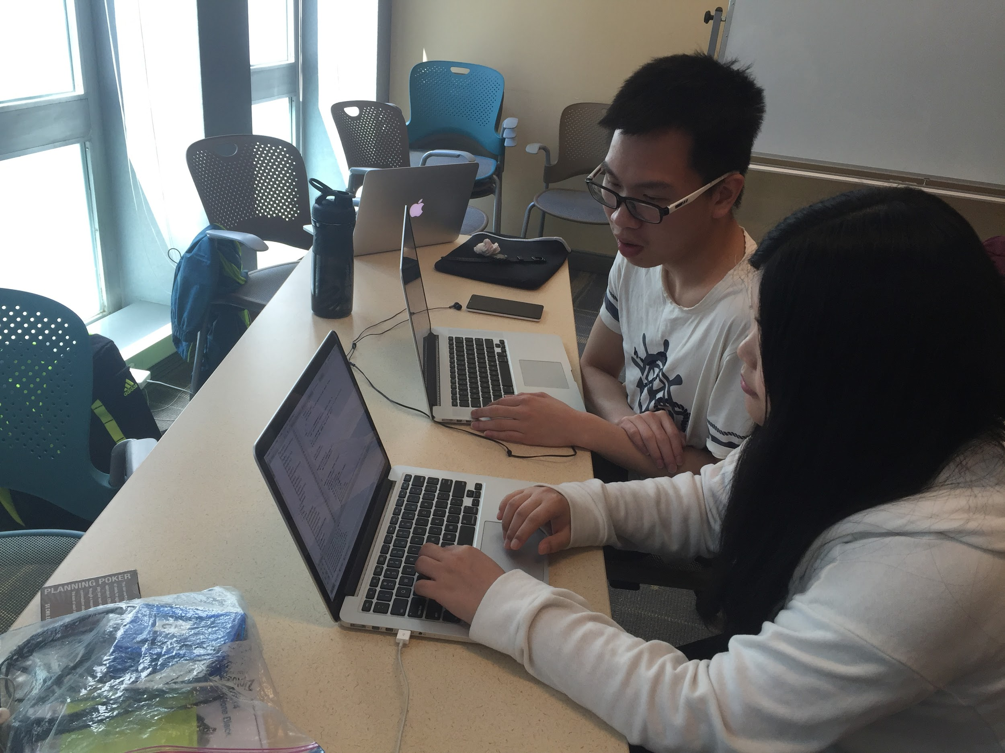
Software Engineering Practices

Slide 47
Quality Attributes
External/ Runtime/ Visible
Performance
Robustness
Reliability
...
Internal/No-Runtime/Invisible
Testability
Portability
Reusability
Extensibility
...

Slide 48
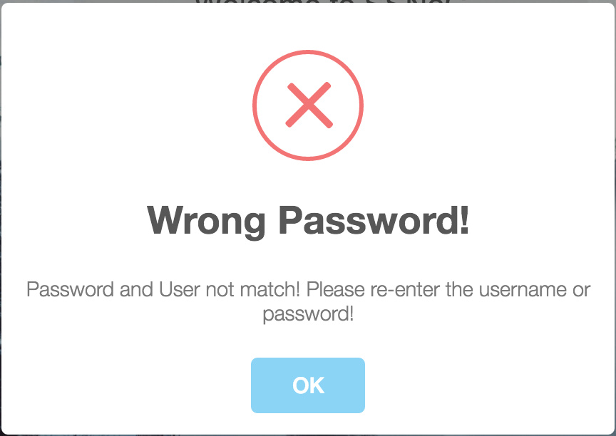
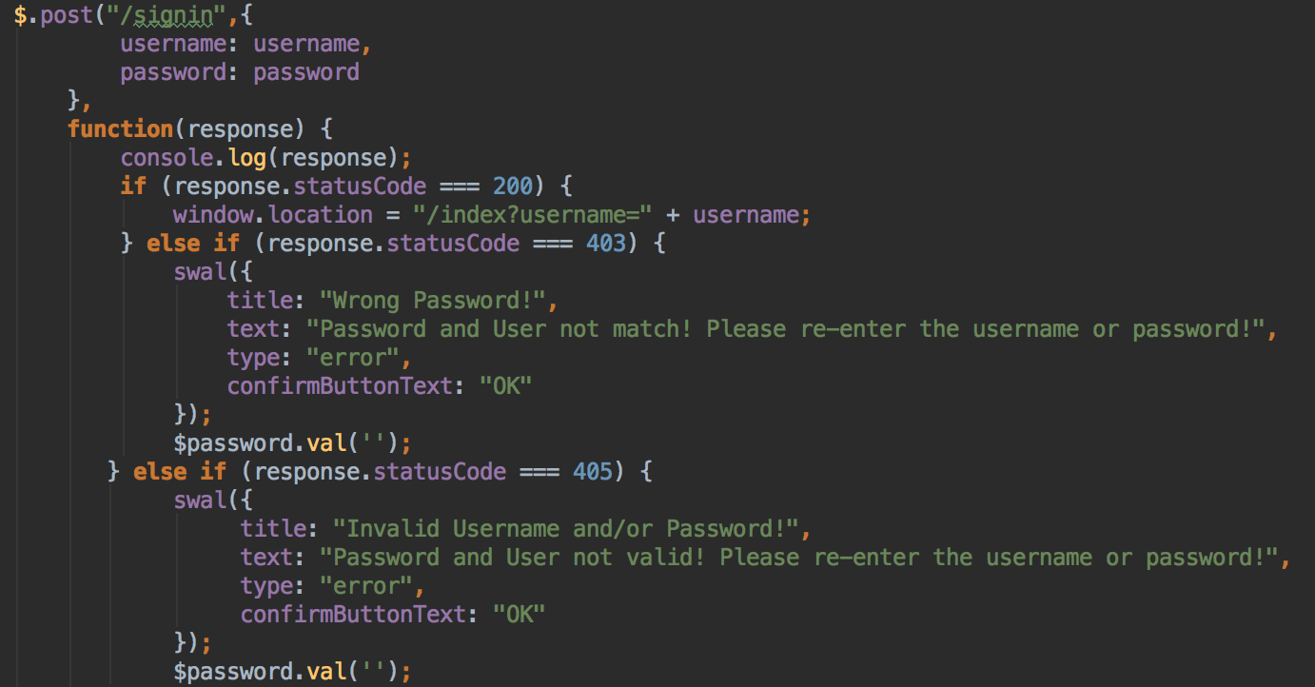
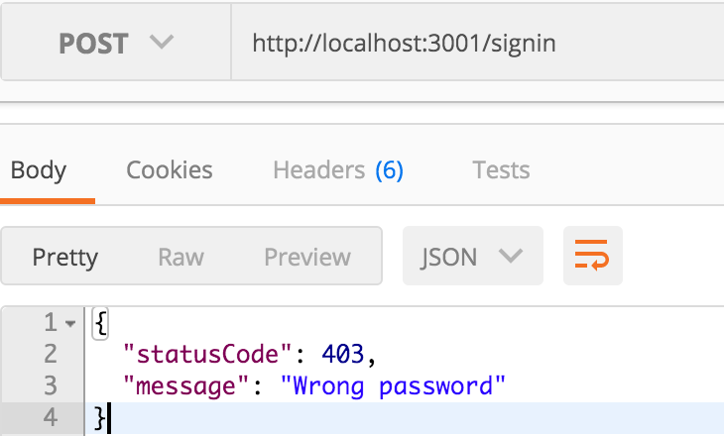
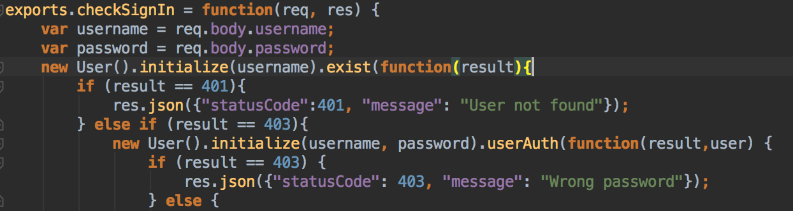
Software Engineering Practices
Front-end: Handle “wrong password” login
Back-end: Handle “wrong password” login

Slide 49
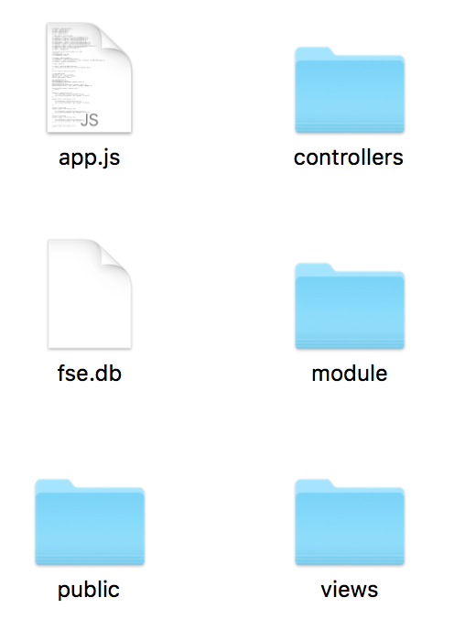
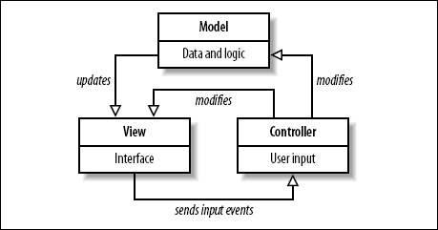
Software Engineering Practices
Separation of concerns
Model: data, domain knowledge
Controller: user interactions, flow
View: display, layout, presentation, visual elements

Slide 50
Lessons Learned
5

Slide 51
Lessons Learned
Four Most valuable lessons
Give TDD a Try
Happy Pair Programming
Pay Your Debt Early
Build You Project with MVC Architecture

Slide 52
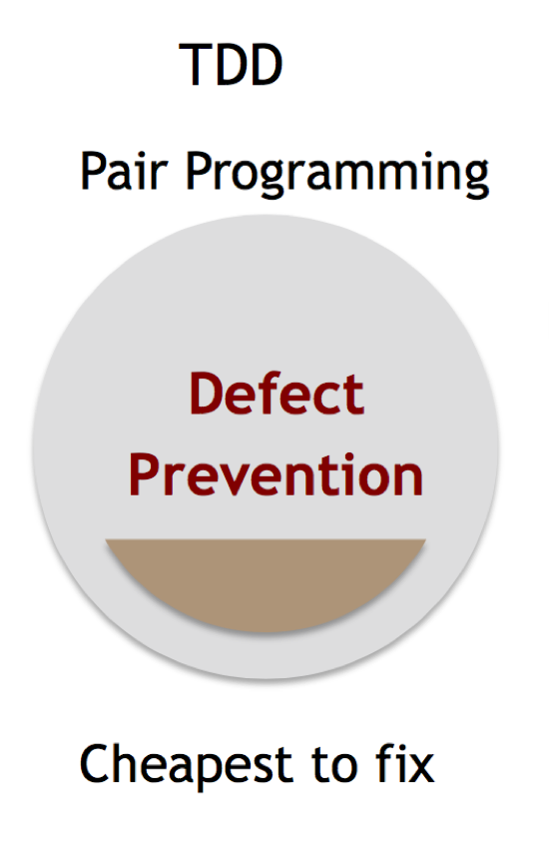
Give TDD a Try
Before
Write tests later
No idea about the direction
Unit tests always broke
After
Write tests first
Clearly where to go
Life is better again

Slide 53
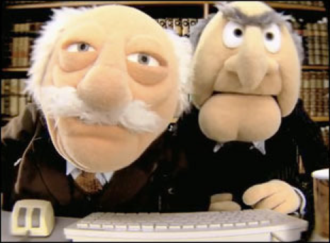
Happy Pair Programming
Before
Stay at home, died alone
Find bugs and fix them by individual
After
Efficiency improves
Find bugs easier
Team work is happy

Slide 54

Pay Your Debt Early
Before
Work later before the due day
Spend much time to pay the debt
After
Efficiency improves
A more elegant use case
Life becomes better again

Slide 55
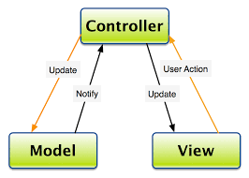
Welcome to MVC Architecture
Before
Everything is in a mess
Hard to follow the code
After
Low coupling
High cohesion
Easy to add a new user case
Easy for a beginner to start

Slide 56
Thank you!

